Slide 1

QUARTERLY BUSINESS REPORT
Prepared By Dhruv Dosad

Slide 2
Agenda
1
Executive Summary
2
Customer Metrics
Distribution of Customers Across States
Customer Satisfaction Analysis
Top Vehicle Makers Preferred By Customers
Most Preferred Vehicle Make in Each State
3
Revenue Metrics
Trend of Purchases by Quarter
Quarterly Revenue Trend Analysis
Average Discount Offered by Credit Card Type
4
Shipping Metrics
Shipping Time Analysis
5
Insights And Recommendations

Slide 3







Executive Summary
Total Revenue
Total Orders
Total Customers
$124.71 M
1,000
994
Last quarter
Last quarter
Last quarter
$23.35M
$5.88M
20.1%
199
30
13.1%
196
32
14.0%
Q4 Revenue
Loss
vs Q3
Q4 Orders
Less
vs Q3
Q4 New cust.
Less
vs Q3
Avg. Rating
Positive Feedback
Avg. Shipping Time
3.07
41.8%
105 Days
Last quarter
Last quarter
Last quarter
2.40
2.96
0.56Pts
20.1%
37.6%
17.5PP
174 D
118 D
56 Days
Q4 Rating
Q3 Rating
vs Q3
Q4 +ve%
Q3 +ve%
vs Q3
Q4 Time
Q3 Time
vs Q3
* The comparison is between last quarter i.e: Q4 vs Q3
* Total customer are the Unique customers & in Q4 represents Unique New Customers acquired
* Customer Rating is in Average
* PP refers to percentage points
* D in Avg shipping time referrers to Days

Slide 4
Executive Summary
Total Revenue
Total Orders
Total Customers
$124.71 M
1,000
994
Last quarter
Last quarter
Last quarter
$23.35M
$5.88M
20.1%
199
30
13.1%
196
32
14.0%
Q4 Revenue
Loss
vs Q3
Q4 Orders
Less
vs Q3
Q4 New cust.
Less
vs Q3
Avg. Rating
Positive Feedback
Avg. Shipping Time
3.07
41.8%
105 Days
Last quarter
Last quarter
Last quarter
2.40
2.96
0.56Pts
20.1%
37.6%
17.5PP
174 D
118 D
56 Days
Q4 Rating
Q3 Rating
vs Q3
Q4 +ve%
Q3 +ve%
vs Q3
Q4 Time
Q3 Time
vs Q3
* The comparison is between last quarter i.e: Q4 vs Q3
* Total customer are the Unique customers & in Q4 represents Unique New Customers acquired
* Customer Rating is in Average
* PP refers to percentage points
* D in Avg shipping time referrers to Days

Slide 5

Customer Metrics

Slide 6
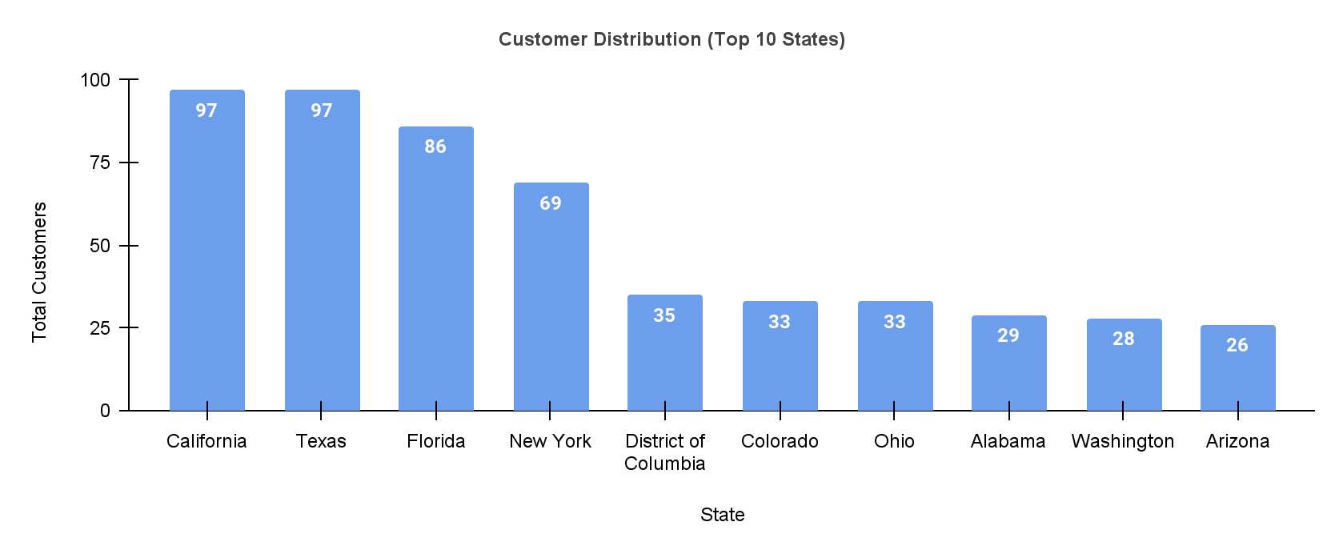
Distribution of Customers Across States
Insights
Customer Distribution:
Over the past four quarters, we have observed a total of 994 customers spread across 49 states.
California and Texas have emerged as the states with the highest customer bases, with 97 customers each.
Following closely, Florida ranks third in terms of customer count, with 86 customers.
Concentration of Customer Base:
The top 10 states account for a significant portion, representing 53.6% of the total customer base.
Notably, the top 4 states alone contribute 35.1% of the total customers.

Slide 7
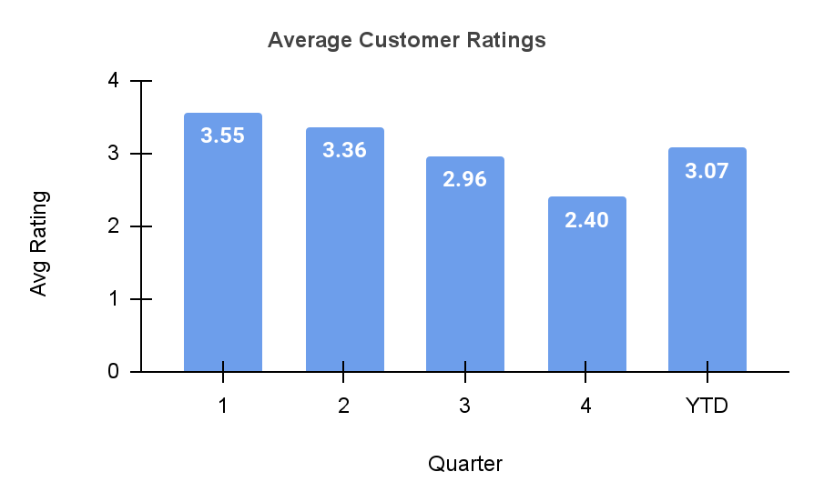
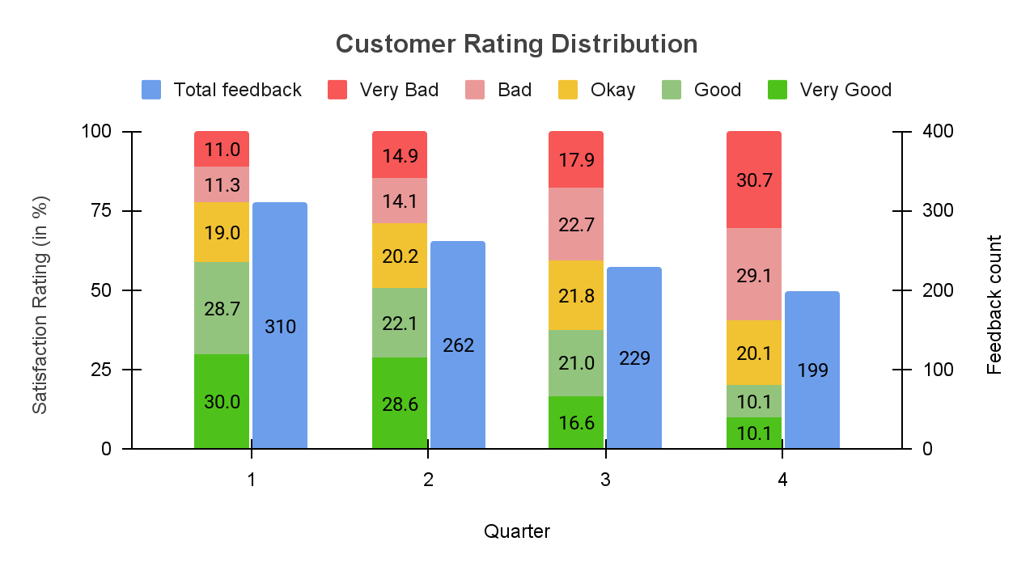
Customer Satisfaction Analysis
Quarterly Average Ratings
Trend of Customer Satisfaction
Insights
Continued downward trend observed throughout the year in avg. customer ratings
In Q4, we observe a significant drop to 2.40
The year-to-date (YTD) average rating stands at 3.07.
Insights
Declining trend: % of good ratings consistently decreases across quarters, reaching a low of 20.2% in Quarter 4.
Quarter 3 Shift - % of bad ratings surpasses % of good ratings
% of okay ratings remains relatively stable across quarters.

Slide 8
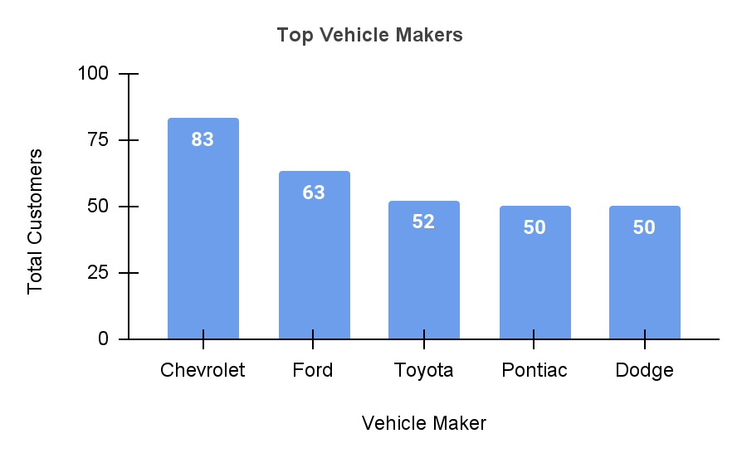
Top Vehicle Makers Preferred by Customers
Insights
Chevrolet leads as the most preferred vehicle maker with the highest customer count, followed by Ford.
Toyota, Pontiac, and Dodge have a similar number of customers, indicating comparable popularity.
Seize the robust demand for Chevrolet and Ford by maintaining a sufficient supply and offering competitive pricing to capitalize on their popularity
Develop targeted approaches to elevate customer engagement and satisfaction for Toyota, Pontiac, and Dodge to boost their market share and strengthen their positions.

Slide 9

Most Preferred Vehicle Make in Each State
State | Vehicle Maker | State | Vehicle Maker | State | Vehicle Maker
Kentucky | Acura | Hawaii | Ford | Kansas | Mercedes-Benz
Louisiana | BMW | Maryland | Ford | Maine | Mercedes-Benz
Wyoming | Buick | Michigan | Ford | New Jersey | Mercedes-Benz
District of Columbia | Chevrolet | North Dakota | Ford | West Virginia | Mercedes-Benz
Massachusetts | Chevrolet | Virginia | Ford | Delaware | Mitsubishi
Missouri | Chevrolet | Illinois | GMC | California | Nissan
Ohio | Chevrolet | Minnesota | GMC | Nevada | Pontiac
Texas | Chevrolet | Iowa | Isuzu | Florida | Toyota
Washington | Chevrolet | South Carolina | Jaguar | Georgia | Toyota
Alabama | Dodge | New Hampshire | Lincoln | Mississippi | Toyota
Idaho | Dodge | Connecticut | Maserati | Nebraska | Toyota
Montana | Dodge | Indiana | Mazda | New York | Toyota
Utah | Dodge | Tennessee | Mazda | Oklahoma | Toyota
 |  | Vermont | Mazda | Oregon | Toyota
 |  | Wisconsin | Mazda | Pennsylvania | Toyota
* Data sorted on Vehicle Make
Note: The above list is not exhaustive. Multiple states may have the same number of vehicles from other makers. For the full list, refer to the complete list here.

Slide 10

Revenue Metrics

Slide 11

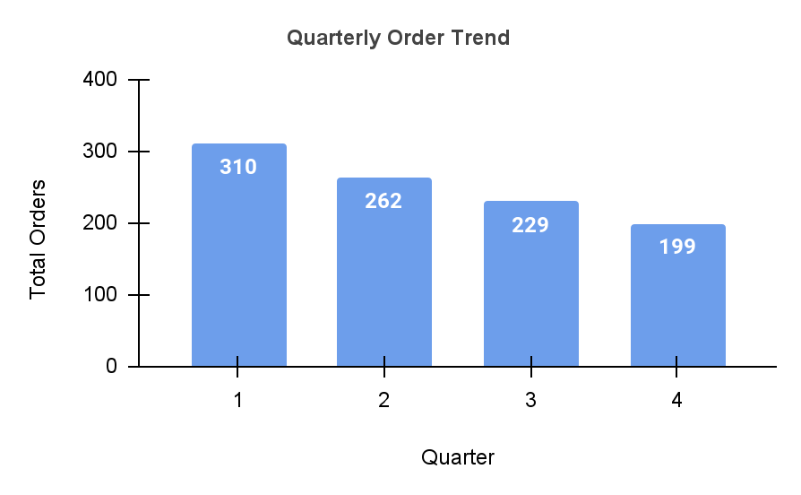
Trend of Purchases by Quarter
Insights
While we have completed 1,000 orders till now, the number of orders has shown a consistent decrease from Quarter 1 to Quarter 4.
Quarter 1 had the highest number of orders at 310, while Quarter 4 had the lowest at 199.
The decline in orders suggests a potential shift in customer demand or market dynamics.
It is crucial to evaluate the factors contributing to the declining trend and identify opportunities for improvement.
Consider conducting market research or customer surveys to gain insights into the reasons behind the decrease in orders

Slide 12

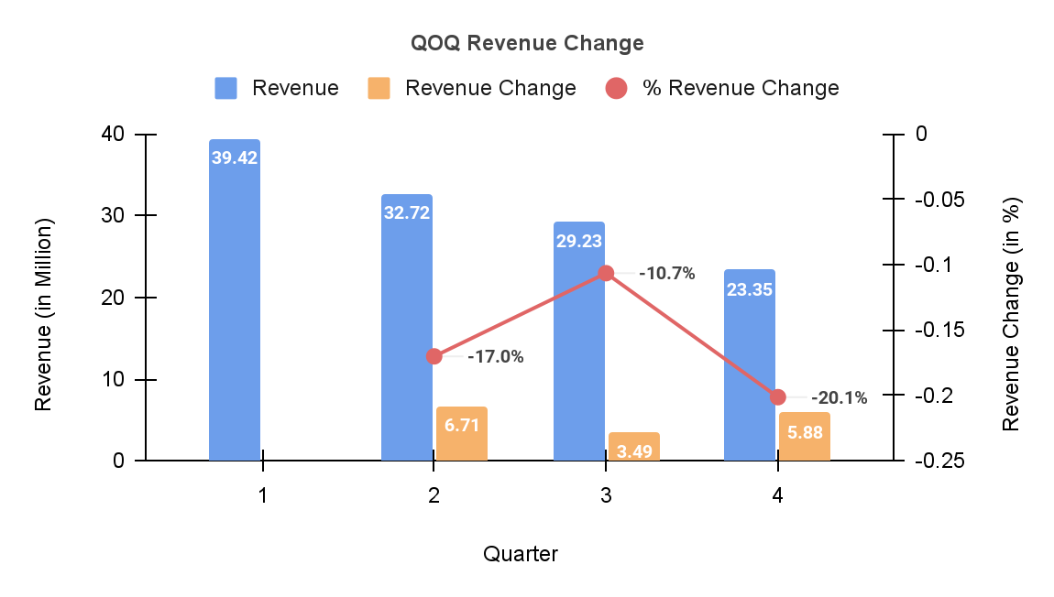
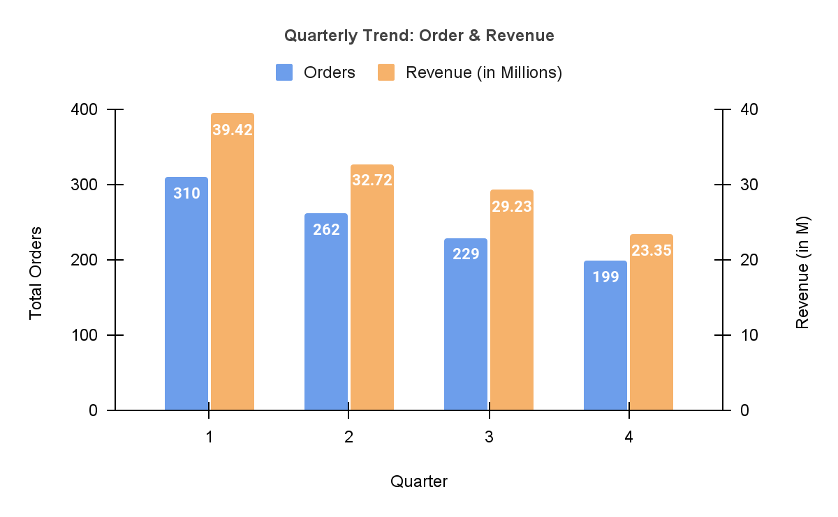
Quarterly Revenue Trend Analysis
Insights
The revenue experienced a downward trend across all the quarters
In Q4, the revenue decreased by -$5.88 M (-20.1%) as compared to the previous quarter.
Insights
Consistent decline observed in both orders and revenue from Q1 to Q4
Orders decreased from 310 to 199, while revenue dropped from $39.42M to $23.35M.

Slide 13

Average Discount Offered by Credit Card Type
Credit Card Type | Avg. Discount
Laser | 64.4%
Mastercard | 63.0%
Maestro | 62.4%
Visa-Electron | 62.3%
China-Unionpay | 62.2%
Instapayment | 62.1%
Americanexpress | 61.6%
Diners-Club-Us-Ca | 61.5%
Diners-Club-Carte-Blanche | 61.4%
Switch | 61.0%
Bankcard | 61.0%
Jcb | 60.7%
Visa | 60.1%
Diners-Club-Enroute | 60.0%
Solo | 58.5%
Diners-Club-International | 58.4%
Insights
Credit Card Preferences: Laser, Mastercard, Maestro, and Visa-Electron have the highest average discounts, while Diners-Club-International and Solo have the lowest.
Range of Average Discounts: The majority of credit card types have average discounts in the range of 60% to 64%.
Quarterly Variation: The average discount offered varied across quarters, with Quarter 3 having the highest average discount (69.8%), and Quarter 1 having the lowest (54.3%). While discount in quarter 4 was 63.8%.
The increase in discounts compared to Quarter 1 has not translated into higher sales, indicating the need to investigate the decline in order count and optimize discount strategies based on customer preferences.

Slide 14

Shipping Metrics

Slide 15
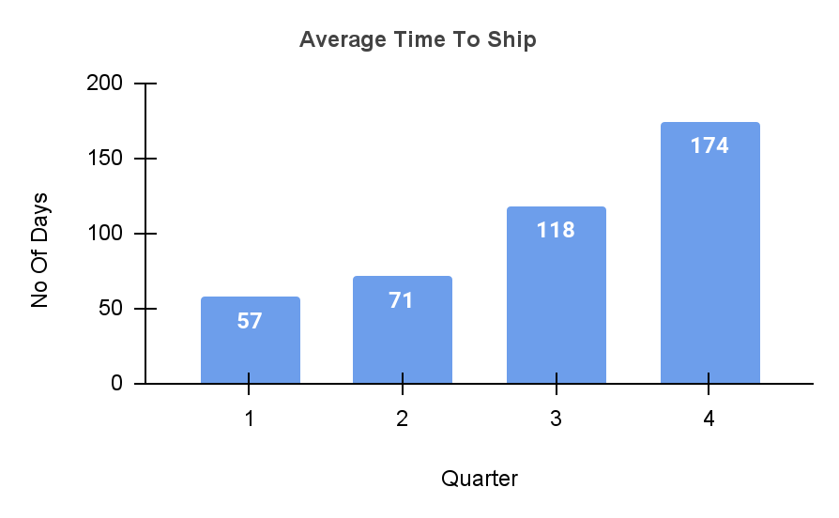
Shipping Time Analysis
Insights
Increased Shipping Time: Average shipping time has significantly increased from Quarter 1 to Quarter 4, with Quarter 4 having the highest average of 174 days.
This might lead users to look for alternatives due to high wait time
No Direct Correlation: Surprisingly, the increase in shipping time doesn't directly correlate with the percentage of bad ratings. Some quarters with longer shipping times have relatively lower percentages of bad ratings.
Further Analysis Required: The relationship between shipping time and customer ratings requires deeper analysis to identify other factors influencing customer satisfaction.

Slide 16

Insights And
Recommendations

Slide 17

Insights and Recommendations
Insights
Customer Satisfaction: The average customer ratings have been declining throughout the year, with a significant drop in Quarter 4 reaching a low of 2.40. Immediate action is needed to address the factors contributing to this decline and improve customer experiences.
Top Vehicle Makers: Chevrolet and Ford are the most preferred vehicle makers, indicating strong demand. Ensure ample supply and competitive pricing. Enhance customer engagement and satisfaction for Toyota, Pontiac, and Dodge to increase market share.
Revenue Decline: Quarter 4 experienced a significant drop in revenue, indicating a decline in sales. Further analysis required on factors like discounts, order count reduction, and shipping time to drive revenue growth.
Shipping Time Analysis: Surprisingly, no strong correlation between shipping time and percentage of bad ratings. Nonetheless, need to optimize shipping processes to improve overall customer satisfaction.
Recommendations
Regional distribution highlights California, Texas, Florida, and New York as key markets. Develop targeted strategies to optimize growth and enhance customer experiences in these regions.
Conduct a customer survey to gather insights and address declining customer ratings.
Develop targeted strategies to capitalize on demand for Chevrolet and Ford vehicles, ensuring sufficient supply and competitive pricing.
Enhance customer engagement and satisfaction for Toyota, Pontiac, and Dodge to increase market share.
Analyze factors contributing to revenue decline (discounts, order count reduction, shipping times). Take necessary actions to drive revenue growth.
Continuously monitor and improve shipping processes for timely deliveries and enhanced customer satisfaction.

Slide 18
Thank You

